Slide 1
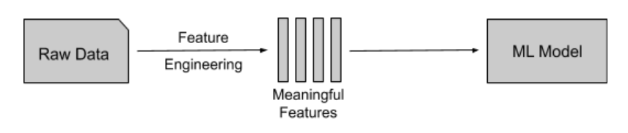
How to put this all into a model?
Explore the features that show difference between different level essays
Put features into an algorithm to predict levels of new essays

Slide 2
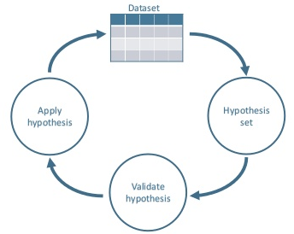
Most Important Features
Average syllables per word
Average sentence length
Flesh Reading Ease
Title synonym text usage
Percentage of words that are:
Nouns
Pronouns
Punctuation
Feature Engineering Cycle

Slide 3

Uses
Teachers:
New to the subject, need guidance
Students:
Provide instantons feedback while working towards their final essay
Parents:
Help their child in a subject they may be less familiar with

Slide 4

Scan our QR Code
Try it for yourself!
TEAM MEMBERS:
Katie WU
Megan WEI
Yves BORENSTEIN
David CHADSEY

